Slide 1
Boss 2
Teleport Boss

Slide 2
Boss Characteristics
Teleports rapidly between several points.
Points are randomly chosen among pre-established points.
If possible, when teleporting, boss should avoid teleporting to the point closest to the player.
To prevent an easy player win. That said, maybe it would be surprising?
Each time the boss enters attack “phase,” he performs between 3-6 attack cycles, the number of which to be randomly determined.
Attack cycle: Throws projectile(s), teleports, repeat. Takes .5 to 1 second for the entire cycle.
After finishing all the attack cycles in an attack phase, the boss “tires out” and pants in a manner obvious to the player, allowing the player to attack him while boss is vulnerable.
Throws one projectile per attack at start. Projectiles are always aimed at where the player is currently standing.
As boss gets more damaged, he throws more projectiles each time he attacks.
Alternatively, the boss could just throw more projectiles to begin with.
Proposal: when boss is one hit away from death, he spams projectiles endlessly in a line toward the player, like a machine gun.

Slide 3
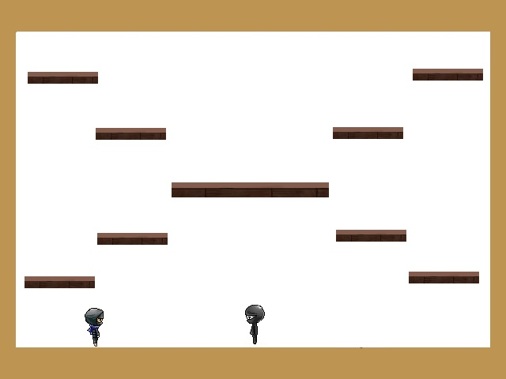
Teleports rapidly between several points. Teleport points:

Slide 4
Rationale for Certain Level Design Decisions
Teleport locations are placed in such a manner to maximize potential distance from the player.
Multiple points so that the player can’t predict where the foe will be and “camp” in a spot that either is safe from the foe or prime for attacking the foe.

